Slide 1

AI CAMPAIGN IN CEE REGION
Andrea Nikolić
February 2019

Slide 2

WHAT IS THE AIQ?
WHAT INFORMATION WILL BE IN AI REPORTS?
WHAT IS THE PURPOSE OF THE CEE CAMPAIGN?

Slide 3
WHAT IS THE AIQ?

Slide 4
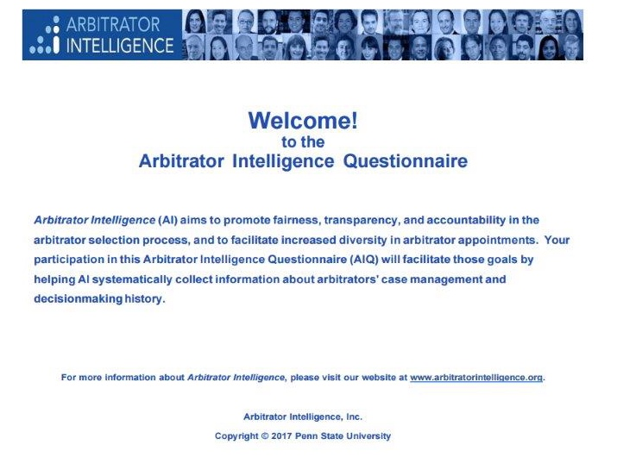
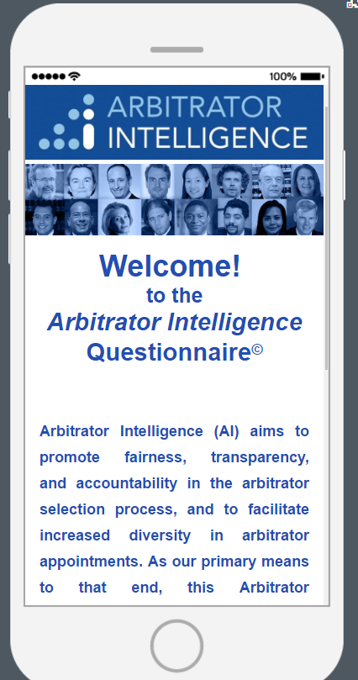

Slide 5






COUNSEL/PARTY/TFP COMPLETES
CONFIDENTIAL ONLINE AIQ
AWARD RENDERED
IN AN ARBITRATION
IN-TELLIGENCE
OUT-TELLIGENCE
ARBITRATOR INTELLIGENCE
ANALYZES DATA FROM AIQS
AI REPORT USED TO
SELECT ARBITRATORS IN
NEW CASE
ARBITRATOR INTELLIGENCE
PRODUCES AI REPORTS

Slide 6

WHO CAN
TAKE THE AIQ?

Slide 7

NOT ARBITRATORS
(or tribunal secretaries)
NOT ARBITRAL INSTITUTIONS

Slide 8
WHAT INFORMATION
WILL BE IN AI REPORTS?

Slide 9
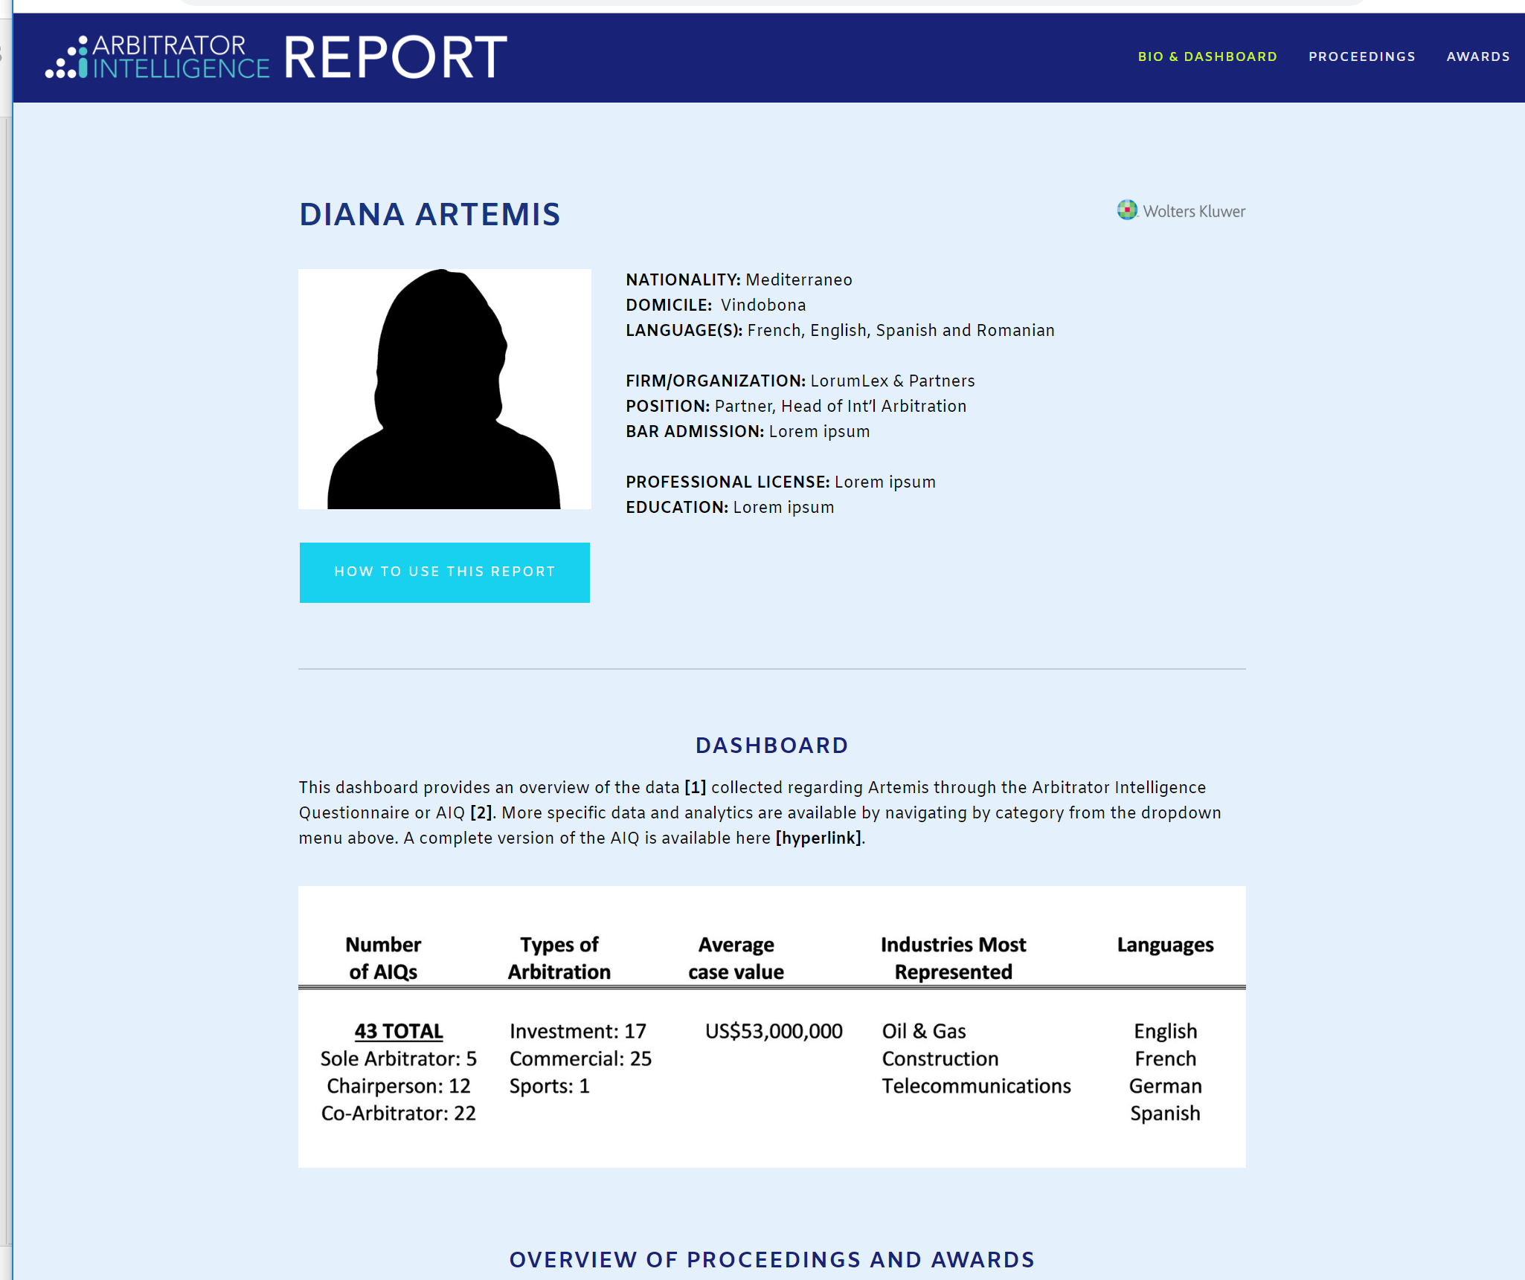

Slide 13
WHAT IS THE PURPOSE OF THE CEE CAMPAIGN?

Slide 14
80% - too many white arbitrators
84% - too many men
64% - too many arbitrators from Western Europe or North America

Slide 15
93% “expertise”
91% “efficiency”
as the most important features in appointing arbitrators
They are looking for “the best person for the job.”

Slide 16
AIQ seeks to disaggregate the abstract qualities of “expertise” and “efficiency” into objective, measurable data points.
For example, to paraphrase a few questions from the AIQ: Did the arbitrators grant document production? Did they ask questions that demonstrated familiarity with the record? Based on data collected through the AIQ, Arbitrator Intelligence will also be able to determine the overall duration of arbitrations and time to issue the award, and numerous other valuable objective data.

Slide 17
92%
Want more information about arbitrators

Slide 18
81%
Want to provide feedback about arbitrators

Slide 19
THANK YOU
& QUESTIONS

